Slide 1
Market Basket Recaps and Ratings & Reviews
SP20 TekGear Mens & Boys

Slide 2
Brand Market Basket - TG Mens
Timeframe: 12/1/19-3/14/20
Within active at Kohl’s, we have a brand loyal Tek Gear customer not driven to crosshop.
Both the % of Shared Transactions & Affinity Index are too low to infer they crosshop the brands listed.
Notes:
For reference:
% of Shared Transactions: The percent of Selected Product Transactions that also includes the Attached Product in the same basket
Affinity Index – Shows the relative importance of the Selected Product to the Attached Product across transactions
A number below 100 means the customer is less likely to purchase the Attached Product with the Selected Product. They are more likely to purchase the Attached Product in a separate transaction rather than purchase it at the same time as the Selected Product
A number above 100 means the customer is more likely to purchase the Attached Product in the same transaction as the Selected Product. They are more likely to purchase the Attached Product and Selected Product in the same transaction

Slide 3
Brand Market Basket - Mens
Timeframe: Fiscal Fall 19
Notes:
For reference:
% of Shared Transactions: The percent of Selected Product Transactions that also includes the Attached Product in the same basket
Affinity Index – Shows the relative importance of the Selected Product to the Attached Product across transactions
A number below 100 means the customer is less likely to purchase the Attached Product with the Selected Product. They are more likely to purchase the Attached Product in a separate transaction rather than purchase it at the same time as the Selected Product
A number above 100 means the customer is more likely to purchase the Attached Product in the same transaction as the Selected Product. They are more likely to purchase the Attached Product and Selected Product in the same transaction

Slide 4
Brand Market Basket cont’d
Notes:
Brand Market Baskets with National brands as the selected product

Slide 5
Style Market Baskets - TG Mens
Dry Tek Shorts:
TG DryTek Short
TG DryTek SS Tee
Dry Tek SS Tees:
TG DryTek SS Tee
TG DryTek Short
Notes:
Conclusion: The customer is buying multiples of the same style

Slide 6
SubClass Market Baskets - TG Mens
Tops:
Bottoms:
Notes:
Based on the subclass market basket recap, the customer is outfitting tops and bottoms within TekGear

Slide 7
Brand Market Basket - TG Boys
Timeframe: 12/1/19-3/14/20
Within active at Kohl’s, we have a brand loyal Tek Gear customer not driven to crosshop.
Both the % of Shared Transactions & Affinity Index are too low to infer they crosshop the brands listed
Notes:
For reference:
% of Shared Transactions: The percent of Selected Product Transactions that also includes the Attached Product in the same basket
Affinity Index – Shows the relative importance of the Selected Product to the Attached Product across transactions
A number below 100 means the customer is less likely to purchase the Attached Product with the Selected Product. They are more likely to purchase the Attached Product in a separate transaction rather than purchase it at the same time as the Selected Product
A number above 100 means the customer is more likely to purchase the Attached Product in the same transaction as the Selected Product. They are more likely to purchase the Attached Product and Selected Product in the same transaction

Slide 8
Brand Market Basket - Boys
Timeframe: Fiscal Fall 19
Notes:
For reference:
% of Shared Transactions: The percent of Selected Product Transactions that also includes the Attached Product in the same basket
Affinity Index – Shows the relative importance of the Selected Product to the Attached Product across transactions
A number below 100 means the customer is less likely to purchase the Attached Product with the Selected Product. They are more likely to purchase the Attached Product in a separate transaction rather than purchase it at the same time as the Selected Product
A number above 100 means the customer is more likely to purchase the Attached Product in the same transaction as the Selected Product. They are more likely to purchase the Attached Product and Selected Product in the same transaction

Slide 9
Brand Market Basket cont’d
Notes:
Brand Market Baskets with National brands as the selected product

Slide 10
Style Market Baskets - TG Boys
Dry Tek Shorts:
TG DryTek Short
TG DryTek SS Tee
TG Textured BBall Short
Dry Tek SS Tees:
TG DryTek SS Tee
TG DryTek Short
Notes:
Conclusion: The customer is buying multiples of the same style

Slide 11
Style Market Baskets cont’d - TG Boys
Graphic Tees:
TG Graphic Tee
TG DryTek Short

Slide 12
SubClass Market Baskets - TG Boys
Tops:
Bottoms:
Notes:
Based on the subclass market basket recap, the customer is outfitting tops and bottoms within TekGear

Slide 13
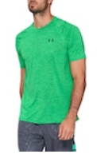
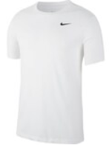
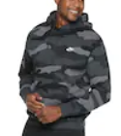
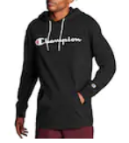
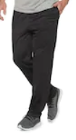
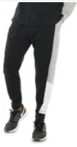
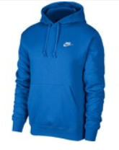
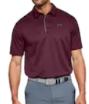
Mens Active Bestsellers - Spring
Timeframe: Spring STD
Top 8 sales volume drivers:
Notes:
Pictures are in order of rankings

Slide 14
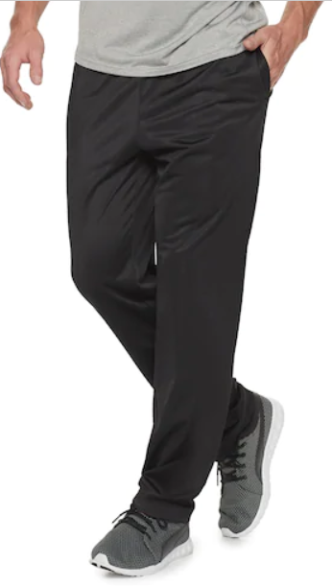
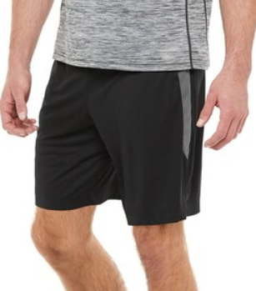
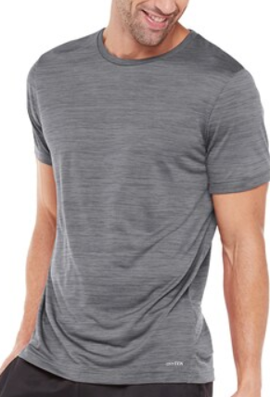
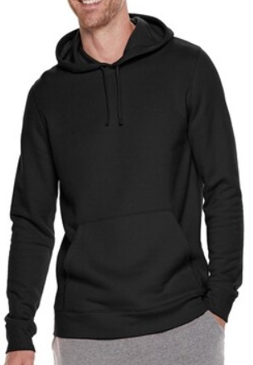
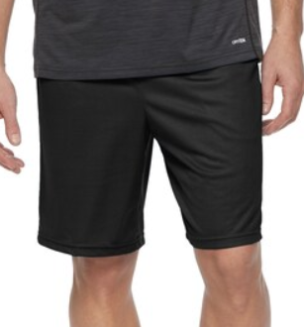
Mens Tek Gear Best Sellers - Spring
Timeframe: Spring STD
Top 5 sales volume drivers:
Notes:
Pictures are in order of rankings

Slide 15
Customer reviews on SP20 best sellers
Men’s Tricot OB Pant
Likes: Soft material, lightweight
Improvements: Fit issues (especially w/ large), elastic band doesn’t hold/waistband gaps, string in waist breaks, legs too slim (12 reviews on fit issues/bad waistband)
Men’s DryTek SS Tee
Likes: Keeps you cool/dry, soft fabric Improvements: Maybe some fit issues (2 reviews)
Men’s Mesh Shorts
Likes: Good quality for price
Improvements: Fit issue - runs small (2 reviews), drawstring too short
Men’s USF PO Hoodie
Likes: soft material, warm
Men’s DryTek Short
Only 2 reviews online right now...4.5 stars
Likes: bought several for gym, comfort

Slide 16
What are our customers saying?
DryTek:
UltraSoft:
Shorts (4.5 stars): comfortable, bought several pairs
SS Tee (4.3 stars): Stays cool & dry, soft, breathable, great for working out, bought several colors
Muscle Tee (5 stars): lightweight but not too thin
LS Tee (5 stars): Fit true to size, soft, comfortable
¼ Zip Top (4.9 stars): lightweight, fits true to size, comfortable, soft
PO Hoodie (4.5 stars): soft, comfortable, bought multiple colors, good quality fabric
Pants (4.6 stars): soft, nice weight, good side pockets, bought multiple pairs, comfortable
FZ Hoodie (4.7 stars): Soft, comfortable, true to size fit, good quality fabric
Notes:
The reviews under 4 stars: Tricot Pants and B&T styles

Slide 17
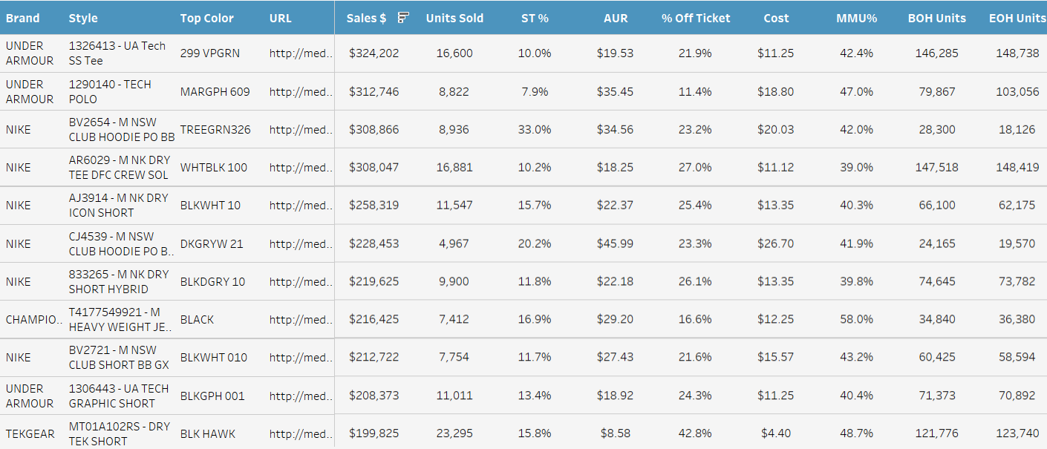
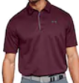
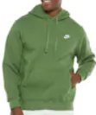
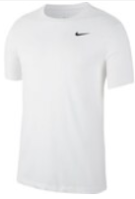
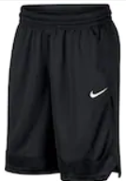
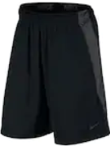
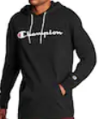
Mens Active Best Sellers - March
Timeframe: March MTD
Top 11 sales volume drivers:
Notes:
Pictures are in order of rankings

Slide 18
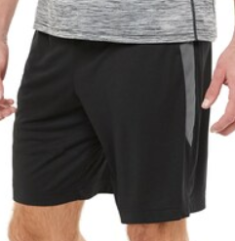
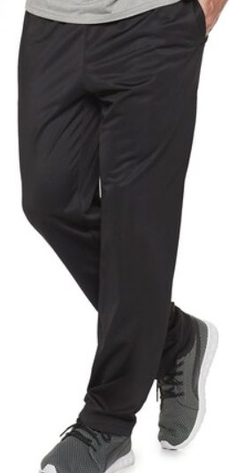
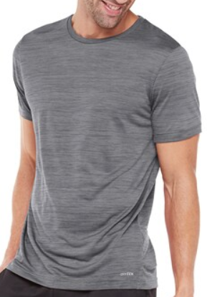
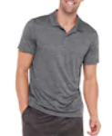
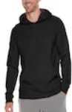
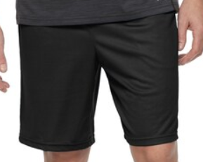
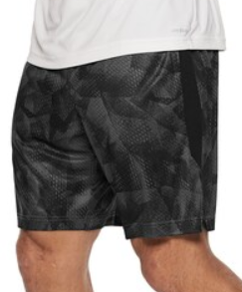
Mens Tek Gear Best Sellers - March
Timeframe: March MTD
Top 7 sales volume drivers:
Notes:
Pictures are in order of rankings

Slide 19
Mens Active Best Sellers - April
Timeframe: April MTD
Top 6 sales volume drivers:
Notes:
adding at the end of April

Slide 20
Mens Tek Gear Best Sellers - April
Timeframe: April MTD
Top 6 sales volume drivers:
Notes:
adding at the end of April

Slide 21
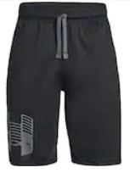
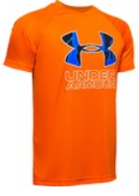
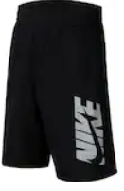
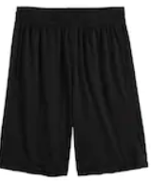
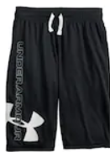
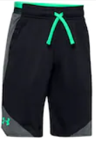
Boys Active Best Sellers - Spring
Timeframe: Spring STD
Top 8 sales volume drivers:
Notes:
Pictures are in order of rankings

Slide 22
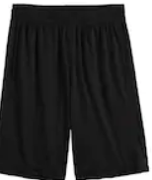
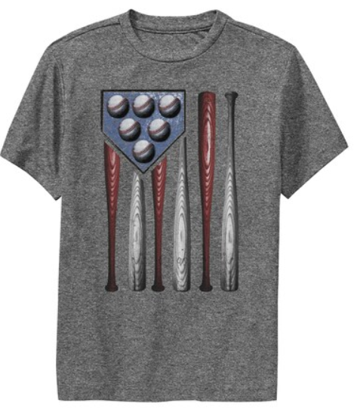
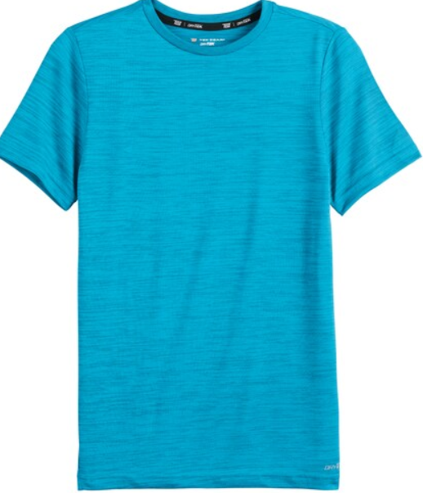
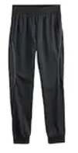
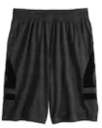
Boys Tek Gear Best Sellers - Spring
Timeframe: Spring STD
Top 6 sales volume drivers:
Notes:
Pictures are in order of rankings

Slide 23
Customer reviews on SP20 best sellers
Boy’s DryTek Shorts
Likes: Soft fabric, fit great
Boy’s Graphic Tee
Likes: Soft material, don’t wrinkle, lightweight Improvements: Inconsistent printing of graphics- some rubbery/sticky feeling others screen print
Boy’s SS DryTek Tee
Only 1 review online right now...and it is 5 stars!
Likes: soft, good for all seasons
Boy’s Tricot Joggers
Likes: Soft material, slim fit
Improvements: Needs stretchier waistband for huskier boys
Boy’s DryTek Textured Basketball Shorts
Likes: Deep pockets for phone, wears all year round, lightweight, soft material, true to size
Improvements: Thin fabric- some colors see through

Slide 24
What are our customers saying?
DryTek:
UltraSoft:
Shorts (4.7 stars): soft, quality fabric, buying many colors to match back to shirts, color: Toucan Green is more neon than the green online
SS Tee (3.9 stars): soft, good for all seasons, stains easily, fit: runs small (6 reviews)
SS Printed Tee (4.3 stars): Lightweight, good colors, soft, stains easily, fit: runs small (2 reviews)
Textured Basketball Shorts (4.6 stars): Deep enough pockets to fit phone, wears all year round, comfortable, true to size, easy to move in
OB Pants (4.4 stars): Warm, soft, comfortable, pockets, fit: run big (5 reviews)
Joggers (4.9 stars): warm, comfortable, easy to move in, pockets, true to size
FZ Hoodie (4.6 stars): good transitional layering piece, warm, soft, good color choice, zipper broke (2 reviews)
FZ Colorblock Hoodie (3.7 stars): trims: zipper small & broke (6 reviews)
PO Hoodie (4.3 stars): soft, warm, good quality, true to size fit
Notes:
The reviews under 4 stars: Tricot Pants (bad fitting waistband) and FZ Colorblock hoodie

Slide 25
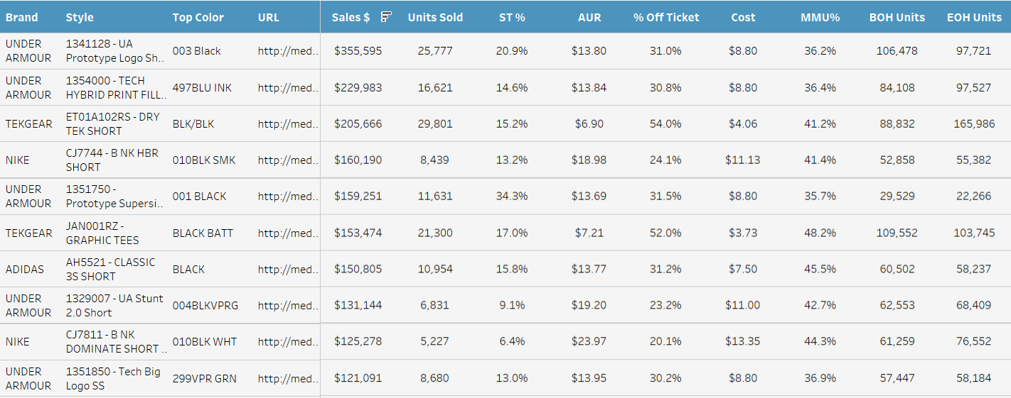
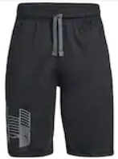
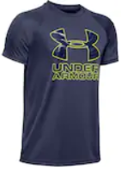
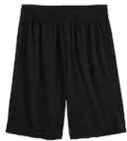
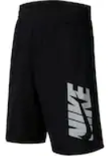
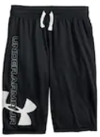
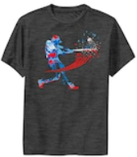
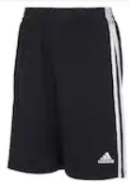
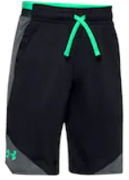
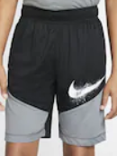
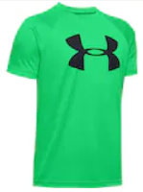
Boys Active Best Sellers - March
Timeframe: March MTD
Top 10 sales volume drivers:

Slide 26
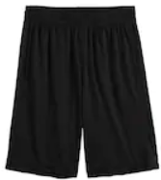
Boys Tek Gear Best Sellers - March
Timeframe: March MTD
Top 6 sales volume drivers:

Slide 27
Key Takeaways
Within active at Kohl’s, we have a brand loyal Tek Gear customer not driven to crosshop
The customer is buying multiples of the same TG style within the same transaction
Opportunity: promotions to encourage buying multiples
Opportunity: Selling 2 packs of dry tek shirts or shorts in core colors
Based on the subclass market basket recap, the customer is outfitting tops and bottoms within TG
Continue giving customers options to match tops & bottoms with color and detail pops
Customer is still buying tricot pants in March
Opportunity: transitional tops & bottoms from fall to spring
There is an opportunity to grow the graphic tee business in both Mens and Boys (adding newness to boys)
DryTek program has positive responses from customers

Slide 28
Boys NPD

Slide 29
All in motion - Kids

Slide 30
All in motion - Kids

Slide 31
All in Motion - Boys

Slide 32
All In Motion - Boys

